Slide 1
CRM Analysis for Enhancing Customer Engagement and Business Growth
Analyzing transaction data to uncover trends, identify segments, and recommend strategies for growth.

Slide 2
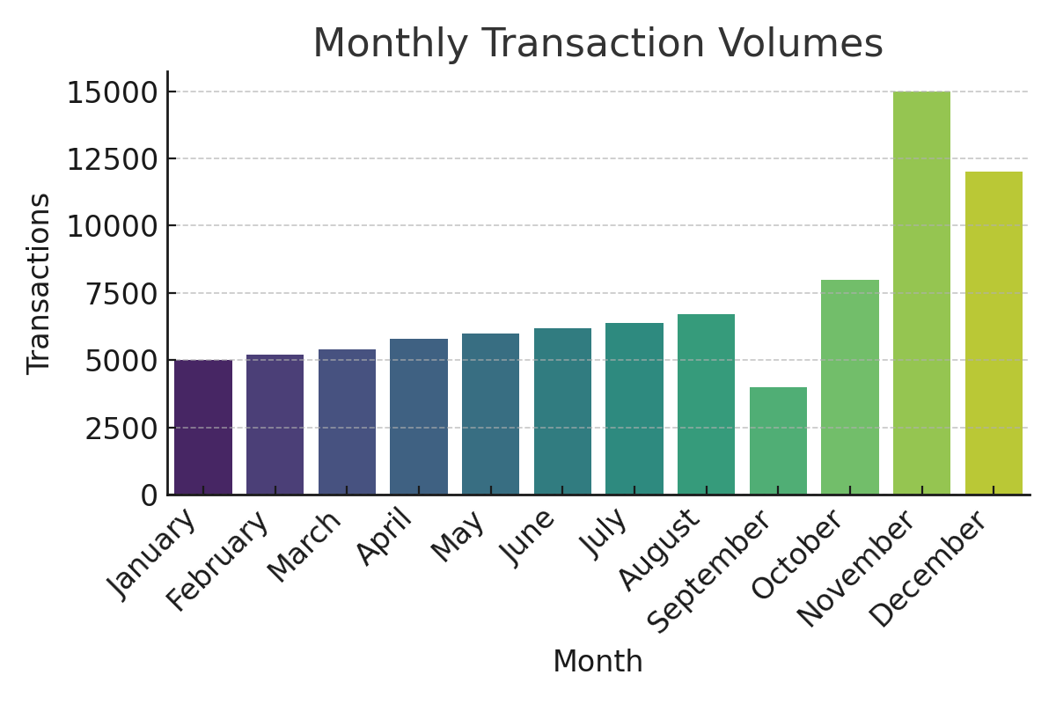
Key Findings from Data Analysis
Peak sales observed in November and December due to holiday season.
September shows the lowest transaction volume.

Slide 3
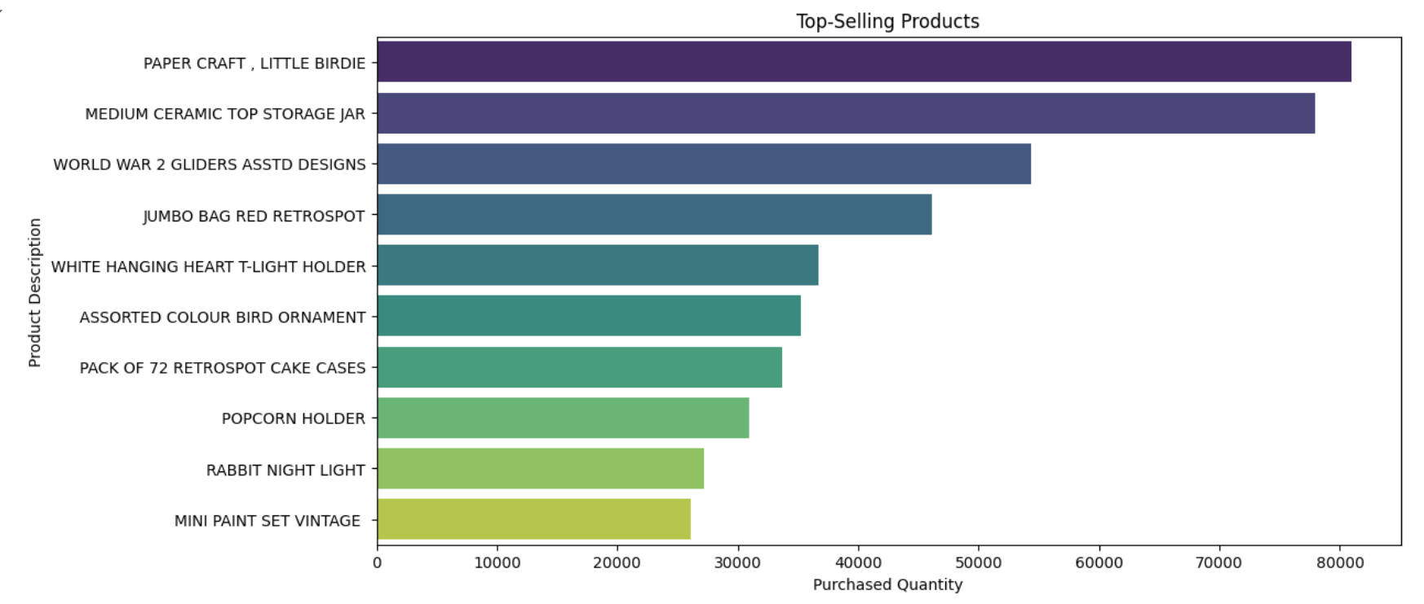
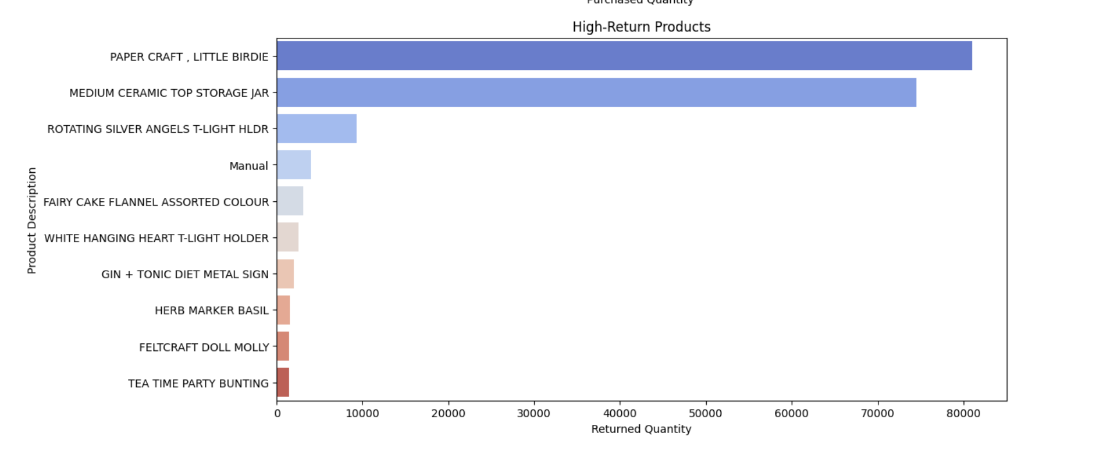
Key Findings from Data Analysis
High-value products, e.g., 'Paper Craft, Little Birdie,' dominate revenue.
High returns correlate with high sales, indicating potential quality issues.

Slide 4
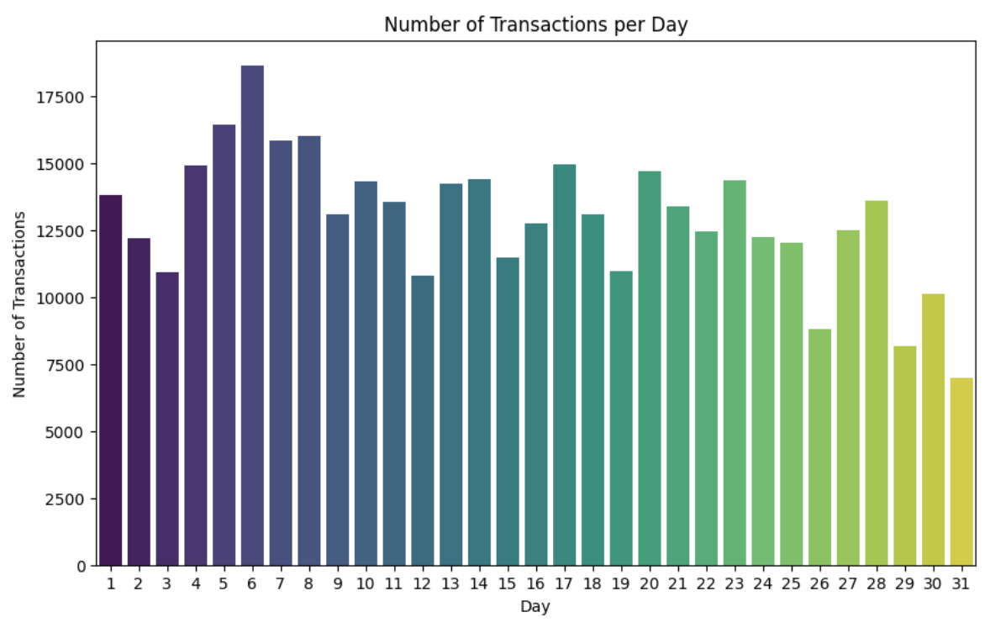
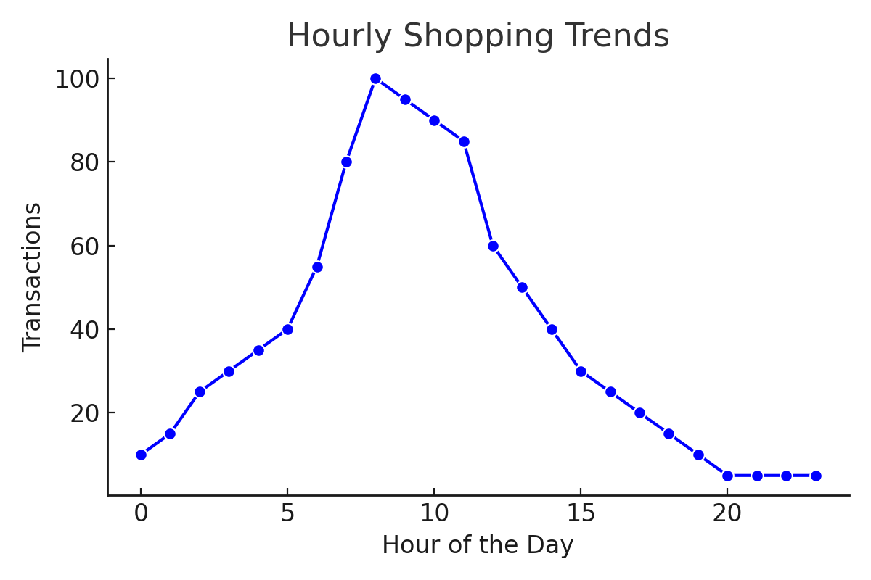
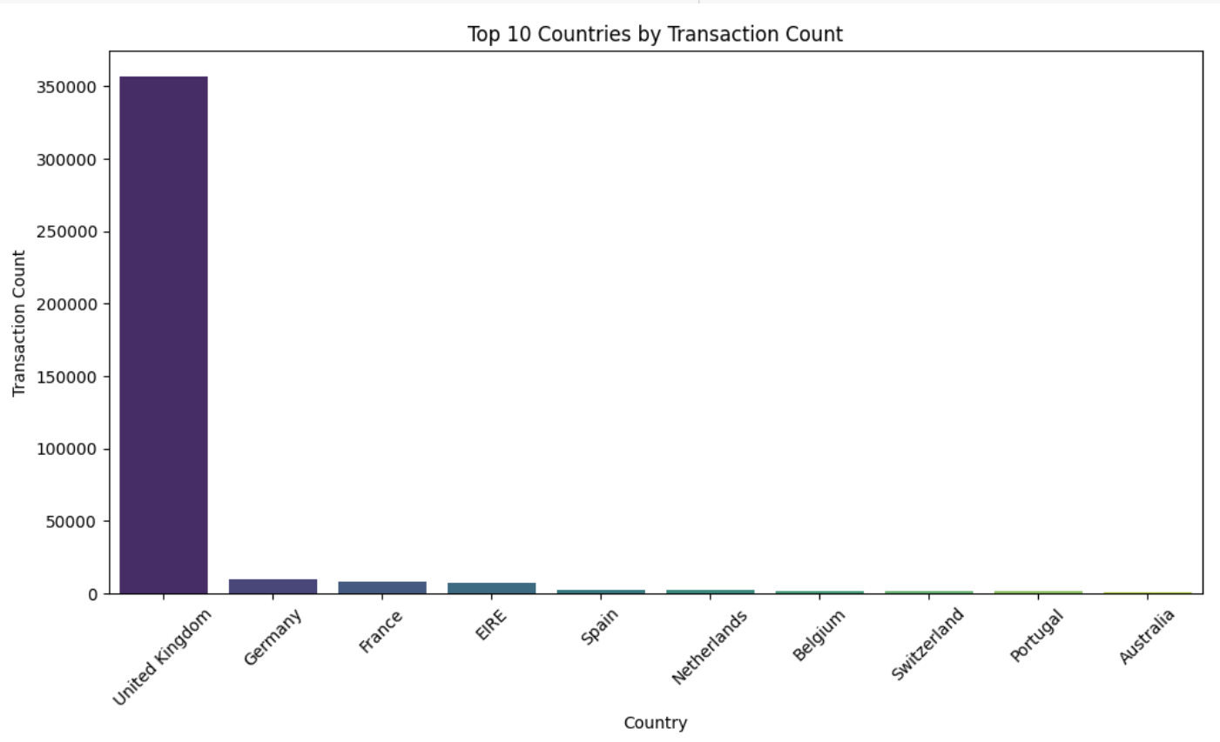
Customer Shopping Behavior
Early month shopping surge, likely tied to paydays.
Peak hours: Morning and early afternoon.
Top-selling products: Decorative and gift items.
UK dominates transactions; opportunities in Germany and France.

Slide 5
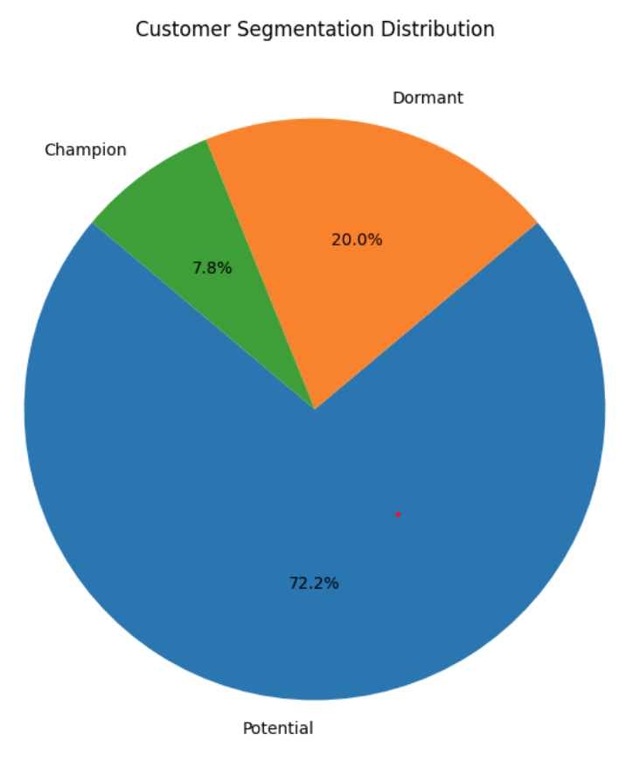
RFM-Based Customer Segmentation
Champions: Highly engaged, frequent buyers, and high spenders. Prioritize them for loyalty programs and special offers.
Potential Loyalists: Customers with moderate recency and frequency but high monetary value. Use incentives to re-engage and convert them into long-term customers.
Dormant: Long periods of inactivity with low engagement. Use targeted campaigns or special offers to reactivate these customers.

Slide 6
Recommendations – Identifying Key Drivers of Customer Behavior
Product Preferences:
Repeat Purchases: Prioritize popular products in campaigns and recommendations.
Discount Sensitivity: Offer targeted discounts to cohorts responsive to promotions.
Purchase Timings:
Seasonality: Plan campaigns around holidays and peak sales months.
Time of Day: Launch promotions during high-activity hours (e.g., evenings).
Return Trends:
High Return Products: Investigate quality issues or mismatched expectations.
Customer Cohorts: Address return rates among specific demographics.

Slide 7
Recommendations – Strategic Marketing & Return Rate Reduction
Personalized Marketing Campaigns:
Targeting High-Frequency Customers: Use loyalty rewards and exclusive offers.
Tailored Product Recommendations: Implement a recommendation engine for cross-selling and upselling.
Time-Based Promotions: Align campaigns with peak shopping hours.
Reducing Return Rates:
Product Quality Improvement: Ensure descriptions and images are accurate.
Flexible Return Policies: Offer enhanced policies for loyal customers.
Post-Purchase Support: Use surveys to understand and reduce returns.

Slide 8
Recommendations – Retention, Satisfaction, and Growth
Customer Retention:
Segmented Strategies: Tailor engagement for Champions, At-Risk, and Dormant customers.
Re-Engagement Campaigns: Offer time-sensitive promotions for inactive customers.
Customer Satisfaction:
Feedback Loops: Use post-purchase surveys to gather insights.
Proactive Support: Provide guides and troubleshooting for better experiences.
Sales Growth:
Data-Driven Campaigns: Align marketing with trends and customer behavior.
Cross-Selling Opportunities: Promote related products to increase order value.

Slide 9

Key Takeaways and Recommendations
Actionable Insights: Identified key drivers of customer behavior, product performance, and engagement strategies.
Key Recommendations: Focus on customer retention, reducing returns, and leveraging data-driven campaigns for growth.
Expected Outcomes: Improved customer loyalty, enhanced satisfaction, and sustainable business growth.
Next Steps:
Implement targeted strategies for high-priority customer segments.
Address return trends and improve product offerings.
Optimize marketing efforts based on insights.
Thank You

